Slide 1
Disaster Tweets Detection
CS-584 Project Presentation
Tianyi Li
2021/5/10

Slide 2
1
Introduction
2
Data Analysis
3
Preprocess the data
CONTENTS
4
Using embeddings
5
Modeling(LSTM,GRU,BERT)
6
Scores and comparing
7
Submission
8
Future work

Slide 3
01
Introduction

Slide 4
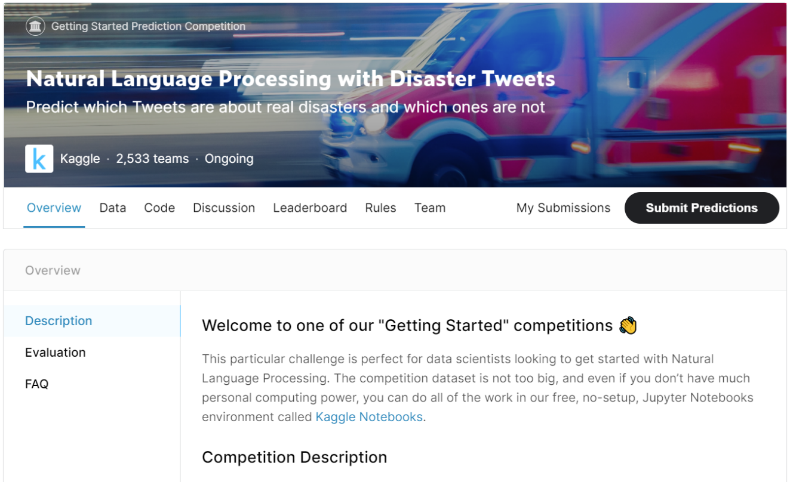
Introduction
Disaster Tweets Detection:
An ongoing competition on Kaggle
Goal:
Predicting which Tweets are about real disasters and which ones are not
https://www.kaggle.com/c/nlp-getting-started/overview

Slide 5
Introduction
Disaster Tweets Detection
Description:
Twitter has become an important communication channel in times of crisis.
https://www.kaggle.com/c/nlp-getting-started/overview

Slide 6
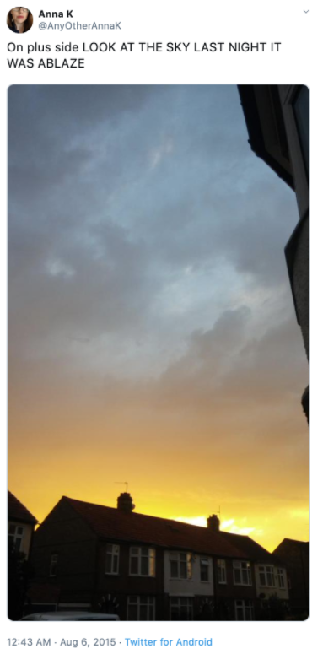
Introduction
Challenge:
It is always bewildering whether the words written by a person really declare a disaster.
https://www.kaggle.com/c/nlp-getting-started/overview

Slide 7
02
Data Analysis

Slide 8

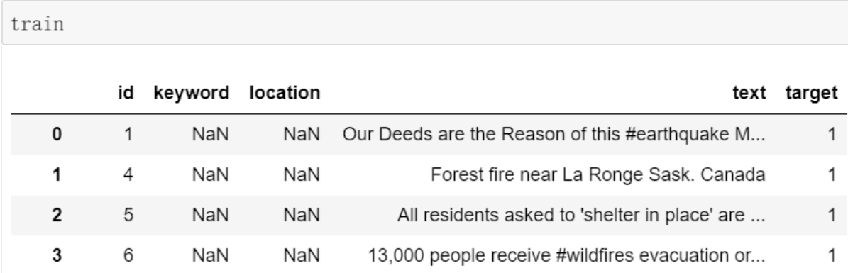
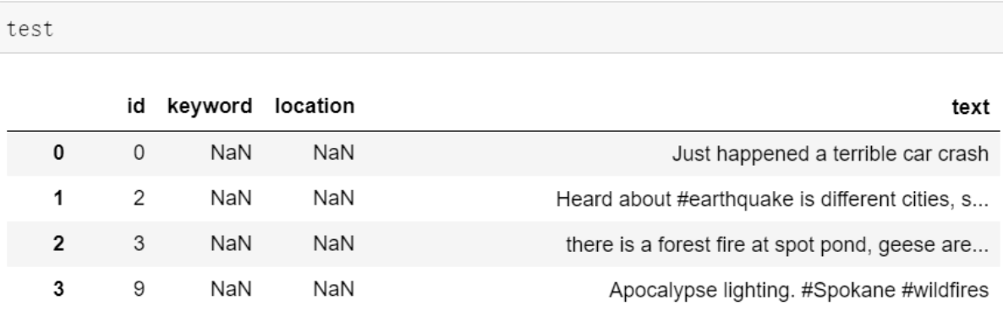
Data Analysis
What files do I need:
train.csv
test.csv
sample_submission.csv
Information:
• The text of a tweet
• A keyword from that tweet (although this may be blank)
• The location the tweet was sent from (may also be blank)

Slide 9
Data Analysis
The meaning of column :
• id
• text - the text of the tweet
• location
• keyword
• target - in train.csv only, this denotes whether a tweet is about a real disaster (1) or not (0)
Submission.csv:
Predicting real disaster(1) or not (0)

Slide 10
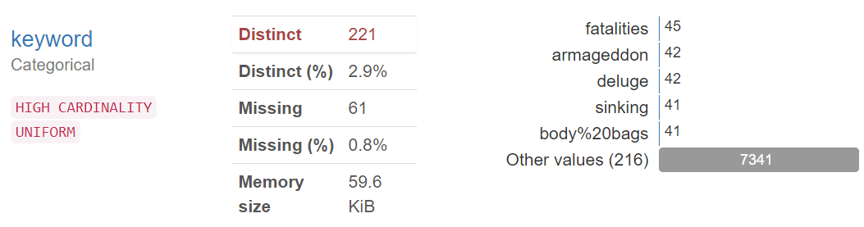
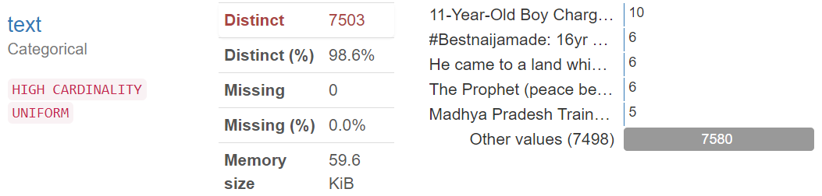
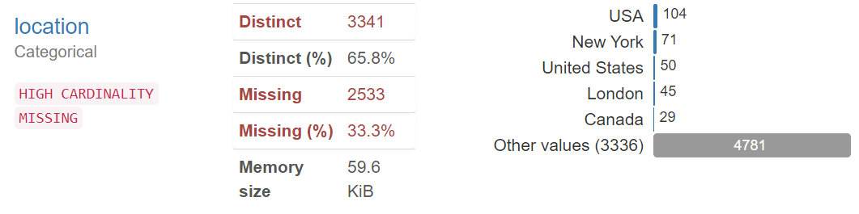
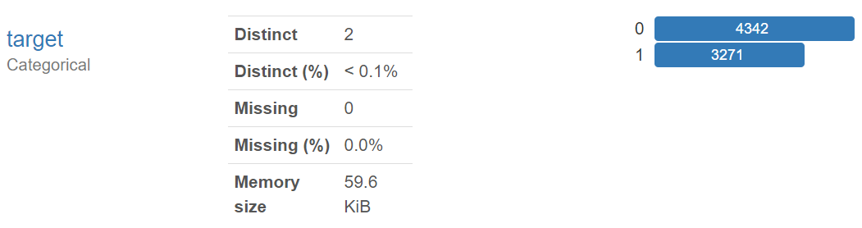
Data Analysis
keyword
location
text
target

Slide 11
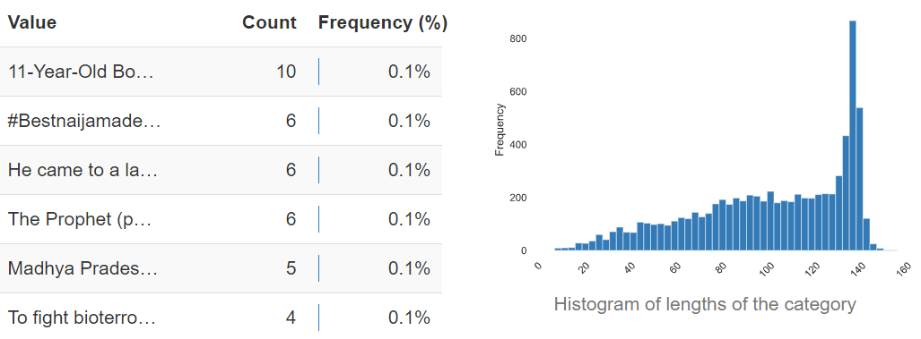
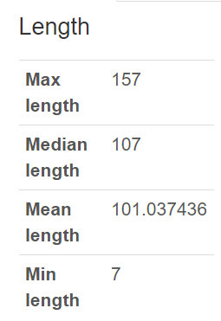
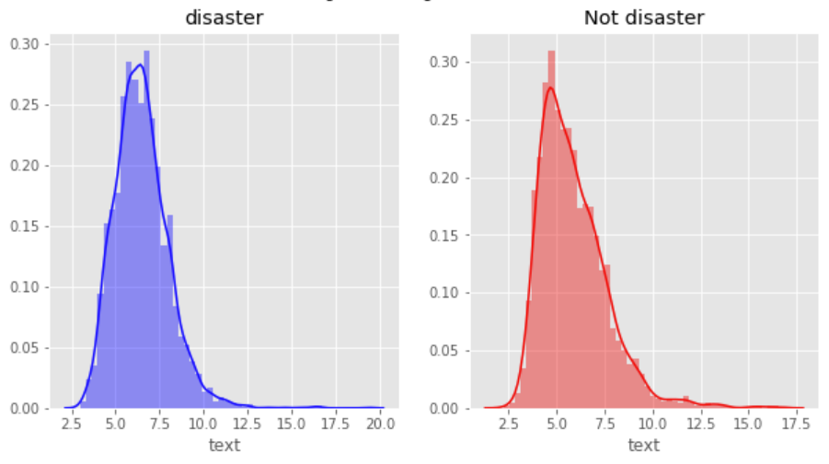
Average word length in each tweet
Data Analysis
Character length of each tweet:
Average word length in each tweet:
6 or so
So, Max words in padding: 15

Slide 12
03
Preprocess the data

Slide 13
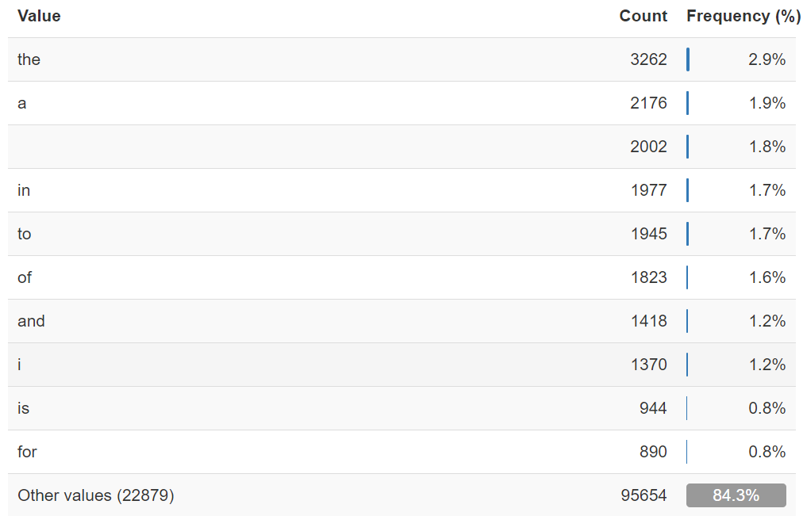
Average word length in each tweet
Preprocess the data
Removing Common stopwords:
Removing HTML tags:
example :
<div> <h1>Real or Fake</h1>
Data cleaning
Removing URLs:
Example: https://www.kaggle.com/
Removing punctuations

Slide 14
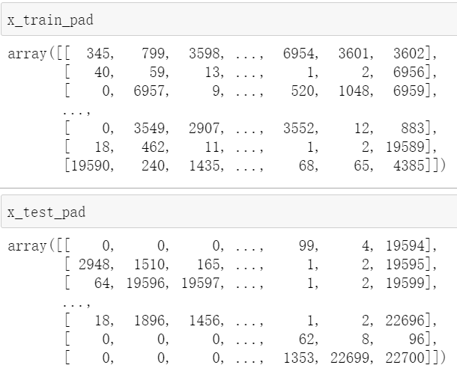
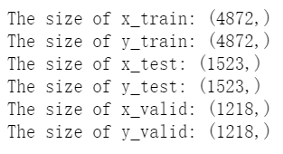
Preprocess the data
Splitting data:
Divide the data set into training set , test set and validation set.
Tokenization and Padding
Max words = 15

Slide 15
04
Using embeddings

Slide 16
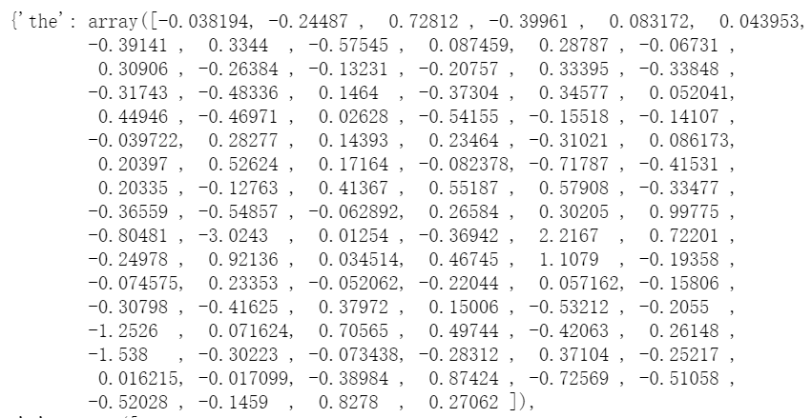
Using embeddings
Initializing word vectors by using pre-trained GloVe model.
Using‘glove.6B.100d.txt ’
- 6 Billion token and 100 Features

Slide 17
05
Modeling

Slide 18
Modeling
LSTM
GRU
BERT
Easier to stores long-term information
Better than simple RNN
Quicker to compute and has fewer parameters than LSTM
Transformer-based
Great performance

Slide 19
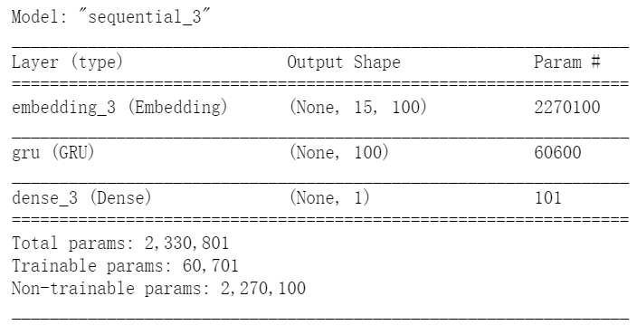
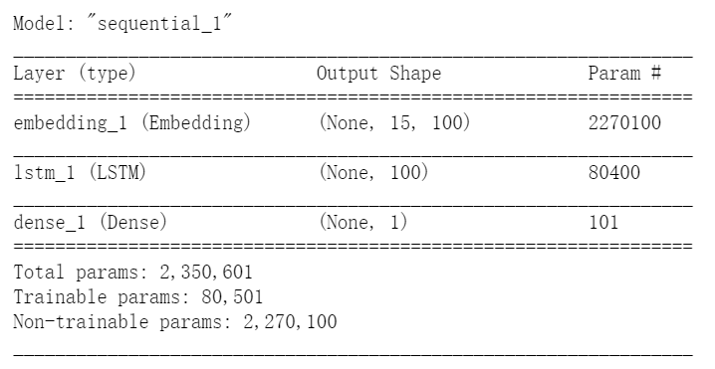
Modeling
LSTM
GRU
Dropout
Activation: 'sigmoid’
loss='binary_crossentropy’
optimizer='adam'
Dropout
Activation: 'sigmoid’
loss='binary_crossentropy’
optimizer='adam'

Slide 20
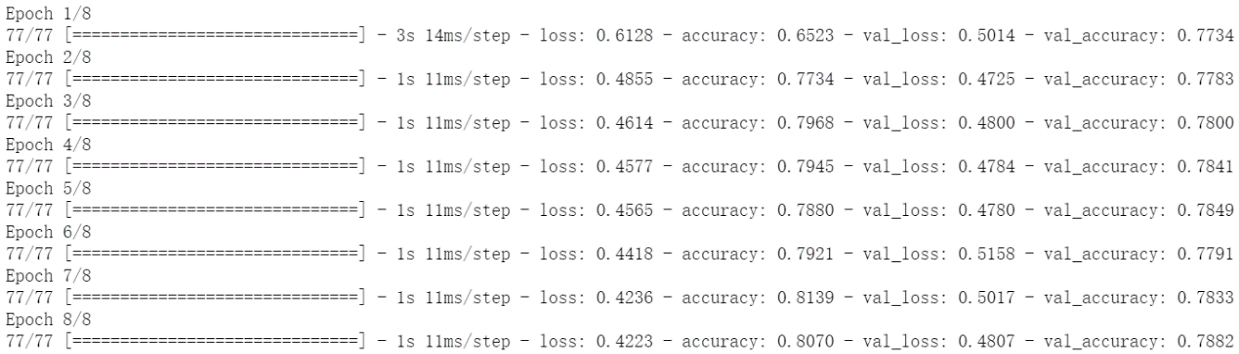
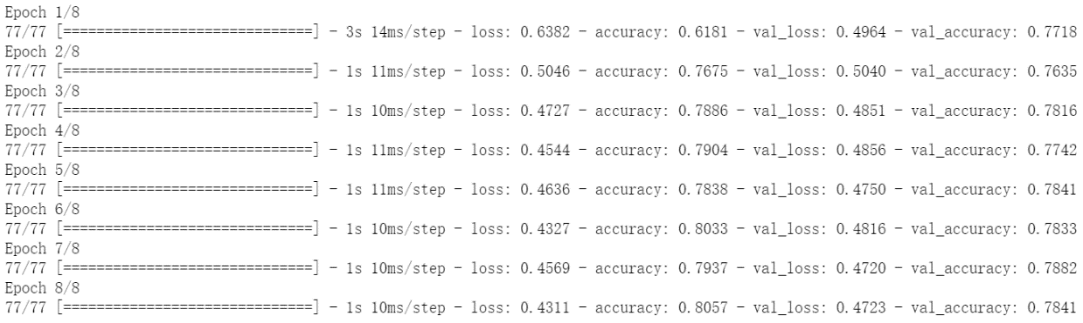
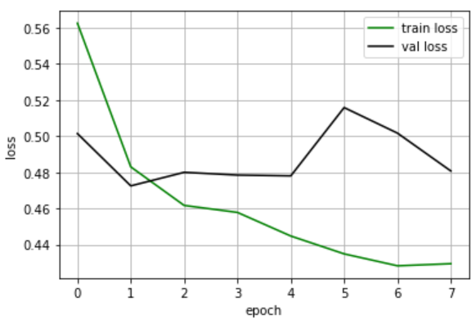
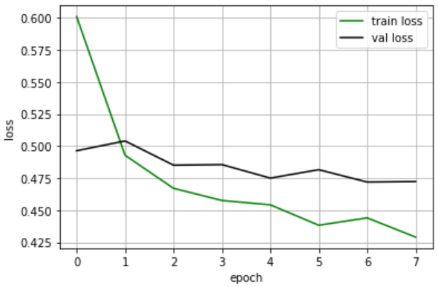
Training
LSTM
GRU

Slide 21
06
Scores And Comparing

Slide 22
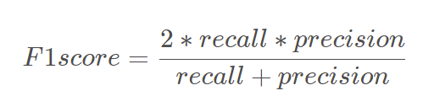
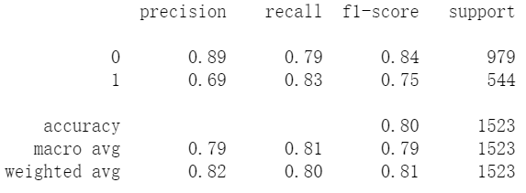
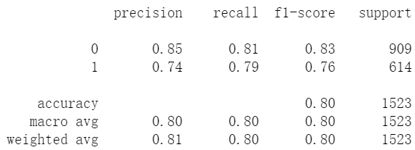
F1 Score
LSTM
GRU
The F1 scores of both models are around 0.8.
They have almost the same performance.

Slide 23
07
Submission

Slide 24
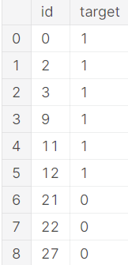
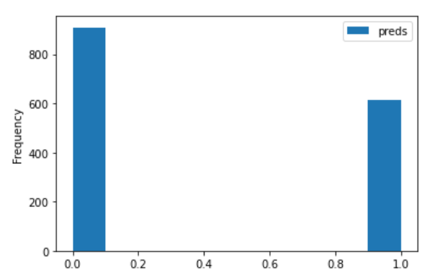
Prediction and Submission
The first few data
The distribution of the predictions

Slide 25
08
Future work

Slide 26
Future work
• BERT
• Cross-validation
• Hyperparameters
• Keywords
• fasttext

Slide 27
Thanks
2021/5/10

